Slide 1

Modules Summary Discussion – Q&A
CR 2.4
Private and Confidential

Slide 2

Making the Bed of the Elder
1
Copyright: iCare Life Pte. Ltd., Singapore : This document must not be copied or shared or circulated without the consent of iCare Life and/or its affiliates.

Slide 3
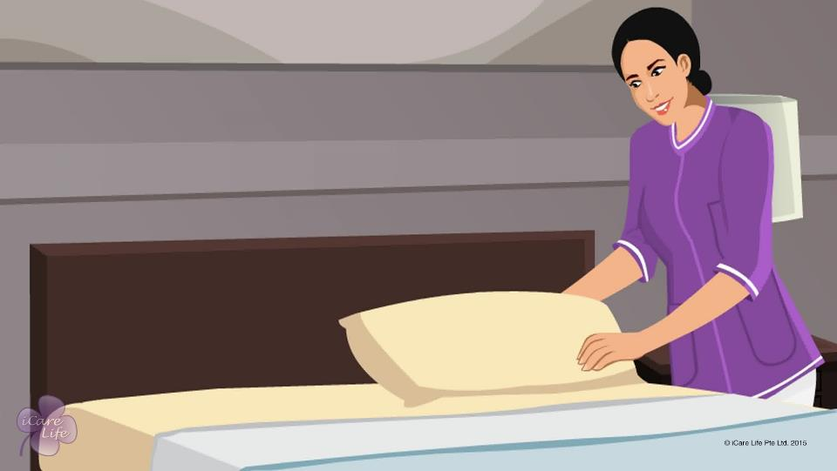
Making the Bed
2
Copyright: iCare Life Pte. Ltd., Singapore : This document must not be copied or shared or circulated without the consent of iCare Life and/or its affiliates.

Slide 4
Summary
Make the bed regularly to prevent dust mites and bed bugs and help the elder sleep better
Use fresh linen bed sheet, top sheet, pillow covers, and blanket or comforter
If the elder is bedridden or has an incontinence problem, also use a drawer sheet and mackintosh sheet
Make the elder’s bed at least twice a day or more often if required
Change the linen once a week or more often if it gets soiled
If the elder is bedridden, you will need to change the linen and make the bed when the elder is still lying on the bed
3
Copyright: iCare Life Pte. Ltd., Singapore : This document must not be copied or shared or circulated without the consent of iCare Life and/or its affiliates.
Notes:
Make the bed regularly to prevent dust mites and bed bugs and help the elder sleep better
Use fresh linen bed sheet, top sheet, pillow covers, and blanket or comforter
If the elder is bedridden or has an incontinence problem, also use a drawer sheet and mackintosh sheet
Make the elder’s bed at least twice a day or more often if required
Change the linen once a week or more often if it gets soiled
If the elder is bedridden, you will need to change the linen and make the bed when the elder is still lying on the bed

Slide 5
Post-Module Activity
Let’s Practice!
4
Copyright: iCare Life Pte. Ltd., Singapore : This document must not be copied or shared or circulated without the consent of iCare Life and/or its affiliates.
Notes:
Arrange for the participants to visit an old age home or the home of an elder. Arrange for a human dummy to pose as a bedridden elder. The participants are divided into small batches and given a demonstration by a trained caregiver on how to make an empty bed and the bed of a bedridden elder.
During the demonstration, participants of each batch can be assigned tasks like changing the sheets, tucking in sheets, smoothening the sheets, etc.

Slide 6
Any Questions?
5
Copyright: iCare Life Pte. Ltd., Singapore : This document must not be copied or shared or circulated without the consent of iCare Life and/or its affiliates.
Notes:
FAQs
Q1. The elder is sleeping all day. I don’t wish to disturb him. Is it okay if I don’t make the bed on such a day?
The bed should be made at least twice a day. If you don’t make the bed regularly, it can attract dust mites and bed bugs and negatively impact the elder’s sleep.
Q2. Why should I put a drawer sheet on the mackintosh sheet?
The mackintosh sheet is made of rubber. It can be uncomfortable for the elder to sleep on the mackintosh sheet. This is why you should put a drawer sheet over it.
Q3. It is difficult to change the bed sheets since the elder is bedridden. Can I ask the family to help?
A. No. You should make the elder’s bed on your own. You should not ask the family to help as they may be busy with their own activities.

Slide 7
Assisting the Elder with Morning Wake Up and Evening Tuck In
6
Copyright: iCare Life Pte. Ltd., Singapore : This document must not be copied or shared or circulated without the consent of iCare Life and/or its affiliates.

Slide 8
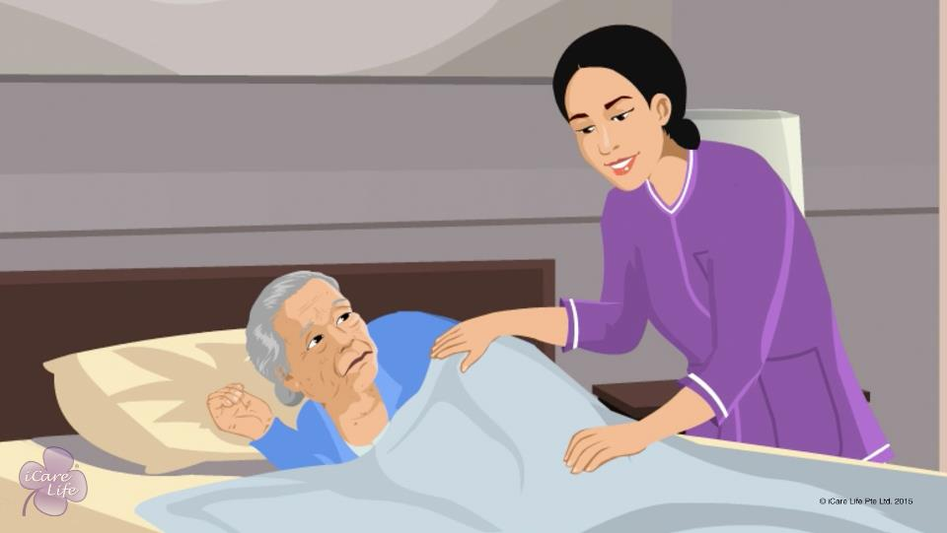
Wake Up and Evening Tuck In
7
Copyright: iCare Life Pte. Ltd., Singapore : This document must not be copied or shared or circulated without the consent of iCare Life and/or its affiliates.

Slide 9
Summary
To put the elder to bed at night:
Serve dinner to the elder
Encourage the elder to do some relaxing activity after dinner
Remind the elder of night time medications
Talk to the elder about the day and interesting things to do next day
Help the elder in brushing and changing into night clothes
Wish the elder good night
Close the curtains and dim the light in the room
Stay nearby till the elder is fast asleep
8
Copyright: iCare Life Pte. Ltd., Singapore : This document must not be copied or shared or circulated without the consent of iCare Life and/or its affiliates.
Notes:
To put the elder to bed at night:
Serve dinner to the elder
Encourage the elder to do some relaxing activity after dinner – such activities can be watching TV for a while or reading a book
Remind the elder of night time medications
Help the elder in brushing and changing into night clothes
Talk to the elder about the day and interesting things to do next day
Wish the elder good night
Close the curtains and dim the light in the room
Stay nearby till the elder is fast asleep

Slide 10
Summary
To wake up the elder in the morning:
Open the curtains
Play soft music
Use a soothing voice to wake up the elder
Wish the elder good morning
Ask whether the elder had a good sleep
Talk to the elder about something to look forward to in the day
Help the elder get out of bed
Assist the elder in brushing teeth or dentures, bathing, and dressing up
Serve breakfast to the elder
Remind the elder of morning medications
Make the elder’s bed
Put the elder’s clothes in washing
9
Copyright: iCare Life Pte. Ltd., Singapore : This document must not be copied or shared or circulated without the consent of iCare Life and/or its affiliates.
Notes:
To wake up the elder in the morning:
Open the curtains
Play soft music
Use a soothing voice to wake up the elder
Wish the elder good morning
Ask whether the elder had a good sleep
Talk to the elder about something to look forward to in the day – this can be an outing or a hobby that the elder likes to pursue
Help the elder get out of bed
Assist the elder in brushing, bathing and dressing up – involve the elder in deciding what clothes to wear
Serve breakfast to the elder
Remind the elder of morning medications
Make the elder’s bed
Put the elder’s clothes in washing

Slide 11
Post-Module Activity
Practical Training
10
Copyright: iCare Life Pte. Ltd., Singapore : This document must not be copied or shared or circulated without the consent of iCare Life and/or its affiliates.
Notes:
The participants are given a live demonstration of waking up elderly people and putting them to bed by trained caregivers. The ideal place for this would be an old people’s home or a nursing home. Fix a prior appointment for the activity and inform the participants of the location and timings for the demonstration.
During the demonstration, participants should be asked to assist the caregiver in performing the wake up and tuck in activities. If additional subjects are available, one by one the participants should be given an opportunity to perform wake up and tuck in activities independently.

Slide 12
Any Questions?
11
Copyright: iCare Life Pte. Ltd., Singapore : This document must not be copied or shared or circulated without the consent of iCare Life and/or its affiliates.
Notes:
Q1. Why shouldn’t I make an elder sleep immediately after dinner?
Ans: Sleeping immediately after dinner leads to many digestive problems. This can cause discomfort to the elder at night and disturb the person’s sleep. Taking a stroll or sitting for a while after having dinner helps in digestion. Since it may be difficult for a person to sit idle, you may involve the person in some relaxing activity like watching TV or reading a book.

Slide 13
Caregiver’s Work Planner
12
Copyright: iCare Life Pte. Ltd., Singapore : This document must not be copied or shared or circulated without the consent of iCare Life and/or its affiliates.

Slide 14
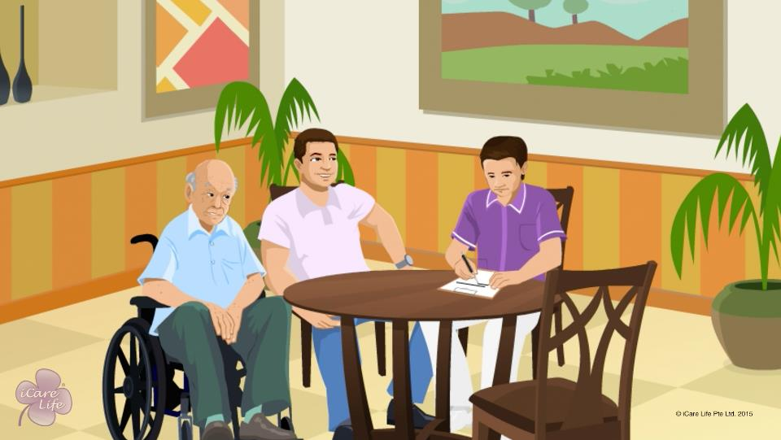
Caregiver’s Work Planner
13
Copyright: iCare Life Pte. Ltd., Singapore : This document must not be copied or shared or circulated without the consent of iCare Life and/or its affiliates.

Slide 15
Pre-Module Activity
Important Information
14
Copyright: iCare Life Pte. Ltd., Singapore : This document must not be copied or shared or circulated without the consent of iCare Life and/or its affiliates.
Notes:
You will require a white board and a marker.
Situation: You are a caregiver and you are on a new assignment. The new care receiver is an eighteen months old baby. The baby is a part of a nuclear family and both the parents are working.
Ask the class participants to list out various pieces of information they would want to know about before they begin. Keep noting these down on the white-board. Strike through them if they are covered in the module later and add some which were not.
A typical list would be:
Baby’s exact age and old records
Baby’s pediatrician's contact details
Parents’ contact details
Any hereditary condition or allergies which the baby has
Baby’s general routine
What does baby like to eat
Any particular medicines which the pediatrician has prescribed (regular/SOS) and their dosage

Slide 16
Summary
Document your correct personal information
Document the care receiver’s personal information
Find out details about the person’s family and its structure
Note important phone numbers
In case of an elder, note down their medical history
Note the personal history of the person
In case of an elder, check and note down their vital information
For a baby or child, check and note down their weight, height, and temperature
15
Copyright: iCare Life Pte. Ltd., Singapore : This document must not be copied or shared or circulated without the consent of iCare Life and/or its affiliates.

Slide 17
Summary
Make a note of the permitted or recommended exercises in case of an elder
For each meal, find out diet options for the person, as per the dietary guidelines and their likes and dislikes
Create a chart detailing all the medicines the person may be taking currently
Observe and document the routines, rules, rituals, and habits of the person under your care and their family
On a daily basis, fill in the weekly log, detailing the daily activities of the person for one week
Use an annual planner to plan for or record important events
16
Copyright: iCare Life Pte. Ltd., Singapore : This document must not be copied or shared or circulated without the consent of iCare Life and/or its affiliates.

Slide 18
Any Questions?
17
Copyright: iCare Life Pte. Ltd., Singapore : This document must not be copied or shared or circulated without the consent of iCare Life and/or its affiliates.
Notes:
Q1. Why is planning essential for both, the care receiver and the caregiver?
Ans. It is important to plan for the following reasons:
(a) To ensure no details are missed out
(b) Care receiver gets all the medicines, food, and recreation etc. on time.
(c) To ensure you can manage your time better and are able to fulfill all your duties in a time bound manner without omitting anything.
(d) To give the family and the doctor a readymade data in a comprehensible manner so as to plan changes if required.
(e) Can help the doctor to foresee any future changes in the condition of the care receiver.
Q2. Is it essential to find out about the allergies, if any of the care receiver?
Ans. Yes, it is very essential to find out about the things that a care receiver may be allergic to. This knowledge can be life saving.
Q3. When you have spent a few weeks or months with the care receiver filling out every detail and knowing the care receiver very closely, can you stop keeping charts?
Ans. One may never be able to predict everything. Events just prior to the event may be extremely important for the doctor and the family to decide upon a course of action. One should, therefore, never compromise on documentation of the care receiver however long the period of care may be.
Q4. Is the chart prepared for the care receiver only a collection of data or can the caregiver put in their own observations?
Ans. It would in fact be a good idea if the care giver puts in their own observations and assessments in the chart. One may not be able to quantify everything. Such observations therefore may be useful at times for the doctor to make their assessment of the care receiver.

Slide 19

Communication and Listening Skills with the Family
18
Copyright: iCare Life Pte. Ltd., Singapore : This document must not be copied or shared or circulated without the consent of iCare Life and/or its affiliates.

Slide 20
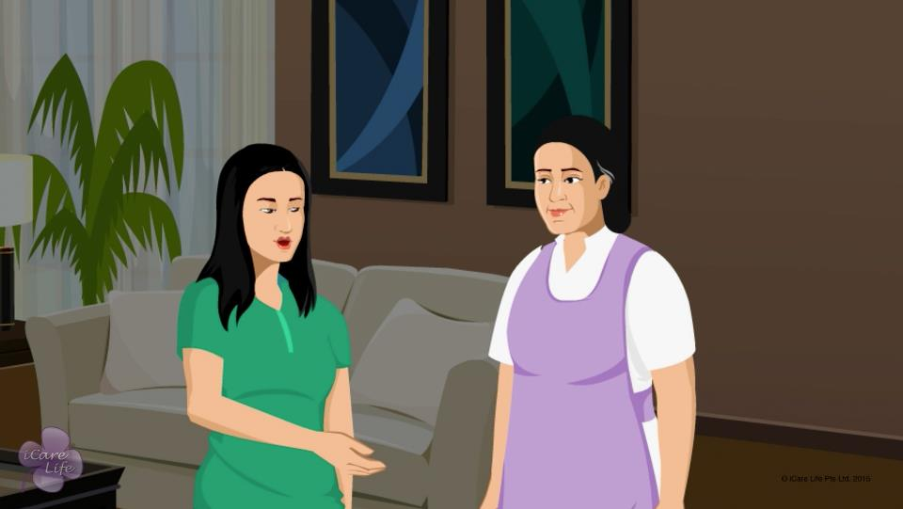
Communication Skills
19
Copyright: iCare Life Pte. Ltd., Singapore : This document must not be copied or shared or circulated without the consent of iCare Life and/or its affiliates.

Slide 21
Post-Module Activity
Say clearly, listen carefully!
20
Copyright: iCare Life Pte. Ltd., Singapore : This document must not be copied or shared or circulated without the consent of iCare Life and/or its affiliates.
Notes:
Communicating Effectively
Explain the following case study to the class.
ABC is a caregiver and takes care of an elder who is 80 years old. The elder is mostly very rude to the caregiver. The elder refuses to take his medicines on time and shouts at the caregiver.
The caregiver tries explaining this to the family, but the family members change the topic of conversation. And so, the caregiver is not able to explain the elder’s behavior to them.’
For the role-play, you can be the family member and ask one volunteer to play the role of the caregiver.
Since you are playing the role of family member, act accordingly and try and interrupt caregiver’s conversation two or three times. The caregiver has to be firm and follow the steps from the module to talk to you.
The rest of the class can be asked for inputs at the end of the role-play about what went right and what could be improved.
Listening Effectively
Tell the group that you will be asking questions on what they are about to hear.
Start by saying you are the bus driver.
You then read out a bus route, for example: You are the bus driver at stop no 1, three people got on the bus, one of them was wearing a red hat.
At stop 2, four people got on and one got off.
At stop 3, two people got on, one person was carrying a bag and the person with the red hat got off.
Continue with this detailed theme.
When you have finished you ask the question: What is the bus drivers age? The majority of people will not have heard the opening line: "you are bus driver".

Slide 22
Summary
Always remember to greet the family members
Maintain a degree of formality and mutual respect
Talk only when you are spoken to
Take the time to explain the problem clearly
Phrase statements correctly
Speak briefly and consistently to maintain the person’s attention
Use the correct body language
Pay all your attention to the person when they are speaking to you
Understand the problem before you think of a response
Do not form opinions before the person has finished speaking
Try to look at the situation from their point of view
Acknowledge what is being said
Be sympathetic and respectful
21
Copyright: iCare Life Pte. Ltd., Singapore : This document must not be copied or shared or circulated without the consent of iCare Life and/or its affiliates.
Notes:
Always remember to greet the family members
Maintain a degree of formality and mutual respect
Talk only when you are spoken to
Take the time to explain the problem clearly
Phrase statements correctly
Speak briefly and consistently to maintain the person’s attention
Use the correct body language
Pay all your attention to the person when they are speaking to you
Understand the problem before you think of a response
Do not form opinions before the person has finished speaking
Try to look at the situation from their point of view
Acknowledge what is being said
Be sympathetic and respectful

Slide 23
Any Questions?
22
Copyright: iCare Life Pte. Ltd., Singapore : This document must not be copied or shared or circulated without the consent of iCare Life and/or its affiliates.
Notes:
Q1. What can I do if I was given some instructions by the family and I did not understand them fully?
Ans. You should let the family members know that you did not understand the instructions. Ask questions for more clarifications and quote examples from previous incidents. At the end of the conversation, summarize what you have understood and remember, so that nothing important is missed.
Q2. How do I ensure an environment of good conversing and listening with an elder I care for?
Ans.
Call the elder by their name, if they prefer
Introduce yourself and share some information about you
Make eye contact with them and give them your full attention
Repeat any instructions which the elder has given you so that you do not miss anything important
Engage in small and easy games so that the elder is engaged more and they talk to you
Talk to the elder in small sentences so that they process the conversation more easily
Appreciate the elder when they perform some tasks well or as per schedule. E.g. eating themselves, taking medicines on time, etc.

Slide 24
Giving Privacy to Care Receiver’s Family
23
Copyright: iCare Life Pte. Ltd., Singapore : This document must not be copied or shared or circulated without the consent of iCare Life and/or its affiliates.

Slide 25
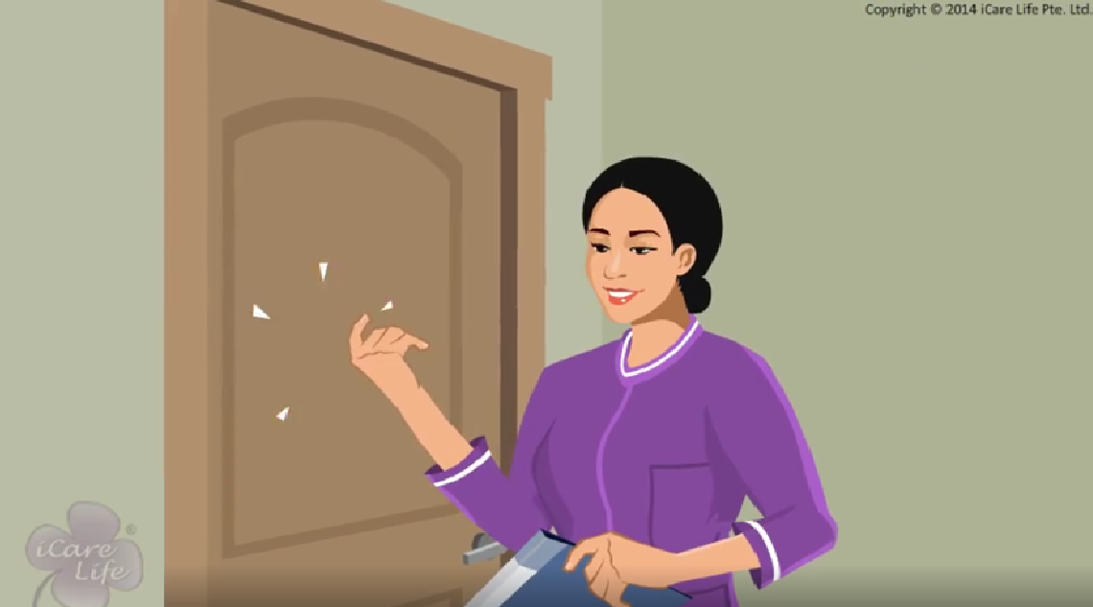
Giving Privacy
24
Copyright: iCare Life Pte. Ltd., Singapore : This document must not be copied or shared or circulated without the consent of iCare Life and/or its affiliates.

Slide 26
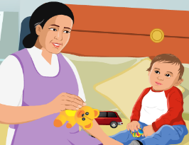
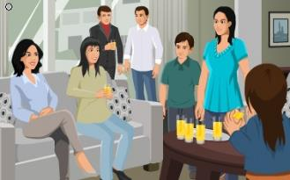

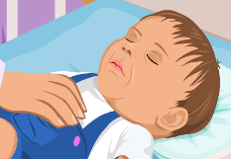

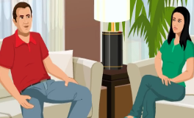
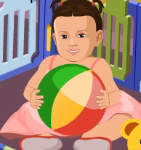
Post-Module Activity
Story Line
4.
4.
25
Copyright: iCare Life Pte. Ltd., Singapore : This document must not be copied or shared or circulated without the consent of iCare Life and/or its affiliates.
Notes:
Divide the class into two groups. Share the case study. Give each group the handouts with the case study and the two questions. Give them 10 minutes to read the case study and discuss their thoughts based on the questions asked. Ask a person from each group to present their thoughts. Discuss with class after both groups finish.
Story 1
The female caregiver takes care of a one and half year old boy. A few guests come to visit the family. The female caregiver goes to the child’s room and continues with her work. When the baby is asleep, the female caregiver goes to the mother’s room and talks about her days in college. Later, she walks into the hall and sees that the parents of the child are talking. She puts the baby and a few toys on the ground and joins in the conversation.
Keeping in mind what you have learned about giving privacy to the care receiver’s family, answer the following:
Q1. What did the female caregiver do wrong? What should she have done instead?
Q2. What did she do right?
Answers:
Q1. What did the female caregiver do wrong? What should she have done instead?
A.
The caregiver shares personal information with family members. In this story, she talks about her college days to the family members. Her focus should always be on her work.
The caregiver should give the family members privacy. In this story, she intrudes on a personal conversation.
Q2. What did she do right?
A. When the guests visited, she stayed away and continued her own work. This is a great example of giving privacy to the care receivers family.

Slide 27
Summary
Allow family members to spend private time with the person under your care
Do not listen to someone else’s conversation
Talk softly
Do not gossip
Do not interfere or involve yourself in matters that do not concern you
Avoid conflict situations and giving your opinion
Avoid engaging in long conversations
Avoid sharing personal information with family members
26
Copyright: iCare Life Pte. Ltd., Singapore : This document must not be copied or shared or circulated without the consent of iCare Life and/or its affiliates.
Notes:
Allow family members to spend private time with the person under your care
Do not listen to someone else’s conversation
Talk softly
Do not gossip
Do not interfere or involve yourself in matters that do not concern you
Avoid conflict situations and giving your opinion
Avoid engaging in long conversations
Avoid sharing personal information with family members

Slide 28
Summary
Never ask a personal question to any of the family members
Always respect the family’s rules
Respect the family’s beliefs
Do not discuss money matters with the family
Do not repeat confidential information shared by a family member to anyone else
Leave the room quietly during personal moments
27
Copyright: iCare Life Pte. Ltd., Singapore : This document must not be copied or shared or circulated without the consent of iCare Life and/or its affiliates.
Notes:
Never ask a personal question to any of the family members
Always respect the family’s rules
Respect the family’s beliefs
Do not discuss money matters with the family
Do not repeat confidential information shared by a family member to anyone else
Leave the room quietly during personal moments

Slide 29
Any Questions?
28
Copyright: iCare Life Pte. Ltd., Singapore : This document must not be copied or shared or circulated without the consent of iCare Life and/or its affiliates.
Notes:
FAQs
Q1: How can I give my care receiver’s family privacy?
Ans: You can give your care receiver’s family privacy by:
Focusing on your duties
Staying away from personal or conflict situations
Avoiding gossip
Q2: What should I do if another person gossips about the person under my care?
Ans: Make an excuse and get back to your work.
Q3. What should I do if the members of the family are arguing?
Ans: Go outside the room till the argument is over.
Q4. What should I do if a family member asks me personal questions?
Ans: Answer politely. Do not get into lengthy discussions.

Slide 30
Working with Doctors
29
Copyright: iCare Life Pte. Ltd., Singapore : This document must not be copied or shared or circulated without the consent of iCare Life and/or its affiliates.

Slide 31
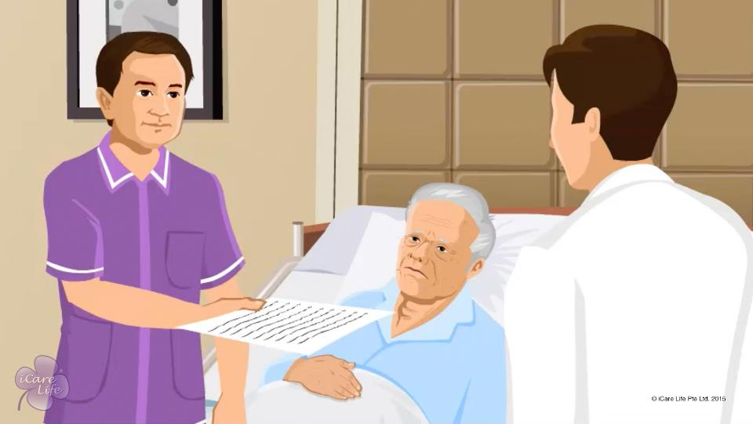
Working with Doctors
30
Copyright: iCare Life Pte. Ltd., Singapore : This document must not be copied or shared or circulated without the consent of iCare Life and/or its affiliates.

Slide 32
Post-Module Activity
Yes or No
Information | Yes/No
The care receiver has not been eating properly for past two days
The care receiver specifically wanted to wear their favorite blue shirt
The care receiver had a mild fever last night
The care receiver has been sleeping more than 14 hours every day
The care receiver wants to go for a walk every day
The care receiver wanted to eat an ice-cream.
The care receiver suddenly became very violent
The care receiver prays for two hours everyday
31
Copyright: iCare Life Pte. Ltd., Singapore : This document must not be copied or shared or circulated without the consent of iCare Life and/or its affiliates.
Notes:
Print the given table for each class participant. Give them 5 minutes to read the sentences and judge whether this piece of information may be noted in the caregiver’s diary. Do explain that there are a lot of things which can be noted down but the participants have to mark a yes for only those pieces of information which could be required by a doctor.
The care receiver has not been eating properly for past two days
The care receiver specifically wanted to wear their favorite blue shirt
The care receiver had a mild fever last night
The care receiver has been sleeping more than 14 hours every day
The care receiver wants to go for a walk every day
The care receiver wanted to eat an ice-cream.
The care receiver suddenly became very violent
The care receiver prays for two hours everyday

Slide 33
Post-Module Activity
Yes or No
Information | Yes/No
The care receiver broke an allergy after eating a new chocolate.
The care receiver is very fond of their new toy.
The care receiver had loose motions the previous night.
The care receiver likes sweets more than salty food.
The care receiver reads a lot and does not talk much.
The care receiver fell down and got hurt, but not very major apparently
The care receiver has a birthmark on the tummy
The care receiver wets the bed sometimes
32
Copyright: iCare Life Pte. Ltd., Singapore : This document must not be copied or shared or circulated without the consent of iCare Life and/or its affiliates.
Notes:
The ideal answers should be:
The care receiver (child) broke an allergy after eating a new chocolate. - Yes
The care receiver (baby) is very fond of their new toy. - No
The care receiver (baby) had loose motions the previous night. - Yes
The care receiver (elder) likes sweets more than salty food. - Yes
The care receiver (elder) reads a lot and does not talk much. - No
The care receiver (child) fell down in the school and hurt their head two days ago. - Yes
The care receiver (baby) has a birthmark on the tummy. - No
The care receiver (child) wets the bed sometimes. - Yes

Slide 34
Summary
Record the reading of the person’s vitals
Record the elder’s blood sugar level
Note down any physical complaints, that the person has
Record any change in the person’s food and fluid intake
Note the frequency, color, and consistency of urine and bowels of the person
Record any deviation in sleep and rest patterns of the person
33
Copyright: iCare Life Pte. Ltd., Singapore : This document must not be copied or shared or circulated without the consent of iCare Life and/or its affiliates.
Notes:
Record the reading of the person’s vitals
Record the elder’s blood sugar level
Note down any physical complaints, that the person has
Record any change in the person’s food and fluid intake
Note the frequency, color, and consistency of urine and bowels of the person
Record any deviation in sleep and rest patterns of the person

Slide 35
Summary
Be aware of the mediation the person is taking
Share all the information with the doctor
Give short but clear answers to any questions that the doctor has
Understand the medication and care plan
Note down the doctor’s instructions
Request the doctor to repeat anything you do not understand
34
Copyright: iCare Life Pte. Ltd., Singapore : This document must not be copied or shared or circulated without the consent of iCare Life and/or its affiliates.
Notes:
Be aware of the mediation the person is taking
Share all the information with the doctor
Give short but clear answers to any questions that the doctor has
Understand the medication and care plan
Note down the doctor’s instructions
Request the doctor to repeat anything you do not understand

Slide 36
Any Questions?
35
Copyright: iCare Life Pte. Ltd., Singapore : This document must not be copied or shared or circulated without the consent of iCare Life and/or its affiliates.
Notes:
Q1. How often should the doctor visit the care receiver?
Ans. It depends on the condition of the patient/care receiver. The family would have worked out some schedule. If in your opinion, having spent some time with the care receiver, the frequency needs any change, the family members must be consulted. In any case, in case of a problem, the doctor must be called immediately.
Q2. How helpful is accurate logging of data regarding care receiver important to the doctor?
Ans. It is extremely important to record the data accurately and regularly. It gives the doctor a chance to look for any future problems that may occur as also in case there is a need for any kind of a change in the present medication or routine. This one factor may actually prove to be life saving.
Q3. How should the data be recorded?
Ans. One of the best ways to record the data is to make charts with rows and columns outlining all possible parameters like blood pressure, sugar levels, sleep patterns, food intake, urination, defecation, any kind of irritation or pain, pulse, medicine taken or refused to be taken by the care receiver, any discomfort followed after taking any particular medicine, exercise undertaken with duration, time spent watching TV, reading, mood changes etc.

Slide 37


